Slide 1

Final Projects
Lehman College— City University of New York
Spring 2016

Slide 2

Course Overview
Focus on New York City (NYC Open Data Project)
Topics:
Working with Data: Scraping Webpages, CSV Files, Regular Expressions, Natural Language Processing
Statistical Tools: Regression, Bayes Theorem, A/B Testing, Distributions
Machine Learning: Training, Classifiers, Nearest Neighbors, SVMs, Neural Networks
Visualizing Data: Principal Components Analysis (PCA), Clustering, Voronoi Diagrams, Multidimensional Scaling
Tools: Python, Statistics, & Linear Algebra

Slide 3
90 Second Previews
Roberto Martinez
Samantha Cardi
Steven Caraballo
Mark Czuy
Anthony Beltran
Tajh McDonald
Francisco Perez
Yusef Abdulla
Osnaldy Vasquez
Edgar Lucero
Elaine Burchman
Antonio Peralta
Rosanna De Leon Rodriguez & Yelso Yanez
Josue Rojas
Rodny Perez
Aurora Koch-Pongsema
Marlon Figuero Lopez
Nicholas Wilk

Slide 4
90 Second Previews
Roberto Martinez
Samantha Cardi
Steven Caraballo
Mark Czuy
Anthony Beltran
Tajh McDonald
Francisco Perez
Yusef Abdulla
Osnaldy Vasquez
Edgar Lucero
Elaine Burchman
Antonio Peralta
Rosanna De Leon Rodriguez & Yelso Yanez
Josue Rojas
Rodny Perez
Aurora Koch-Pongsema
Marlon Figuero Lopez
Nicholas Wilk

Slide 5
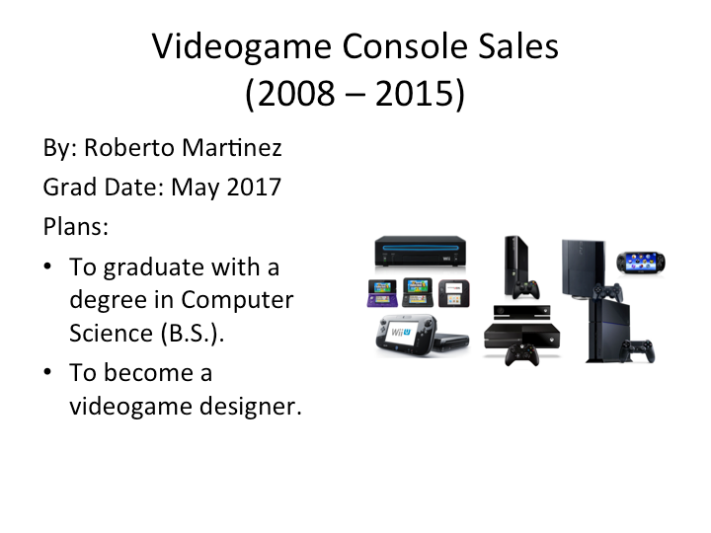

Slide 6
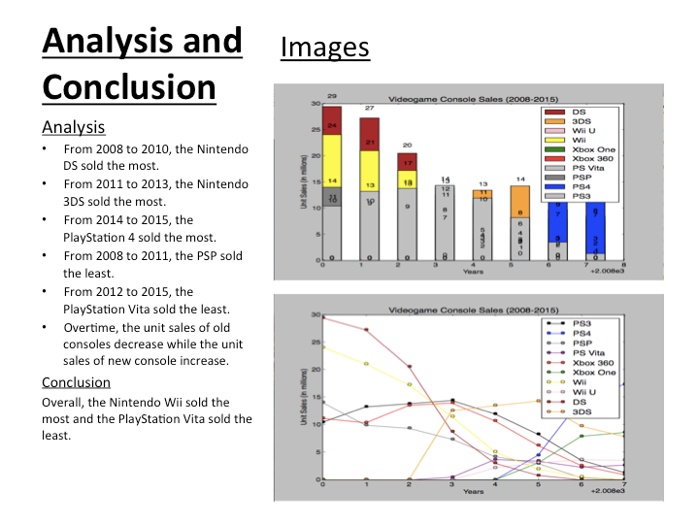

Slide 7
90 Second Previews
Roberto Martinez
Samantha Cardi
Steven Caraballo
Mark Czuy
Anthony Beltran
Tajh McDonald
Francisco Perez
Yusef Abdulla
Osnaldy Vasquez
Edgar Lucero
Elaine Burchman
Antonio Peralta
Rosanna De Leon Rodriguez & Yelso Yanez
Josue Rojas
Rodny Perez
Aurora Koch-Pongsema
Marlon Figuero Lopez
Nicholas Wilk

Slide 8


Slide 9
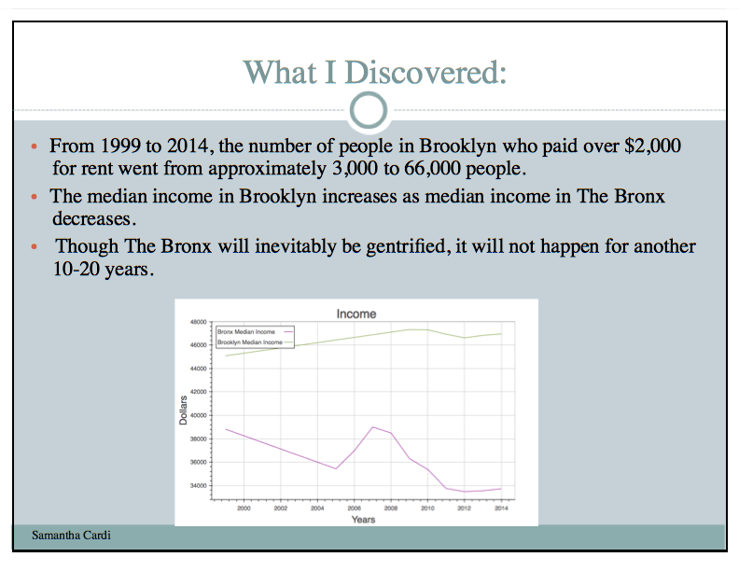

Slide 10
90 Second Previews
Roberto Martinez
Samantha Cardi
Steven Caraballo
Mark Czuy
Anthony Beltran
Tajh McDonald
Francisco Perez
Yusef Abdulla
Osnaldy Vasquez
Edgar Lucero
Elaine Burchman
Antonio Peralta
Rosanna De Leon Rodriguez & Yelso Yanez
Josue Rojas
Rodny Perez
Aurora Koch-Pongsema
Marlon Figuero Lopez
Nicholas Wilk

Slide 11

Baseball Data Science
Steven Caraballo

Slide 12
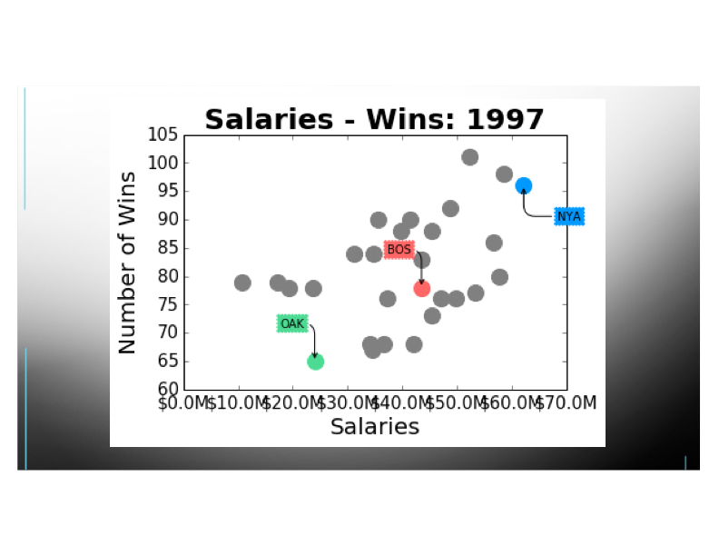

Slide 13
90 Second Previews
Roberto Martinez
Samantha Cardi
Steven Caraballo
Mark Czuy
Anthony Beltran
Tajh McDonald
Francisco Perez
Yusef Abdulla
Osnaldy Vasquez
Edgar Lucero
Elaine Burchman
Antonio Peralta
Rosanna De Leon Rodriguez & Yelso Yanez
Josue Rojas
Rodny Perez
Aurora Koch-Pongsema
Marlon Figuero Lopez
Nicholas Wilk

Slide 14
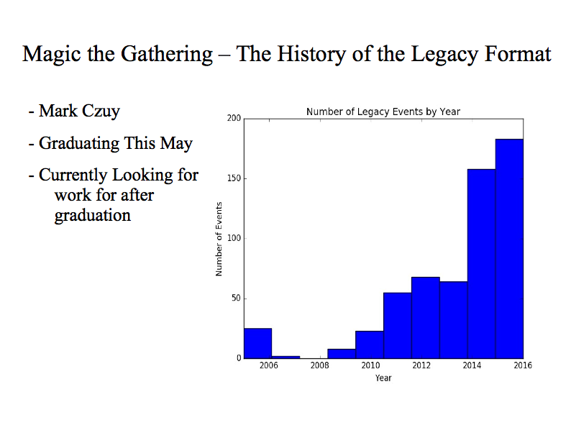

Slide 15
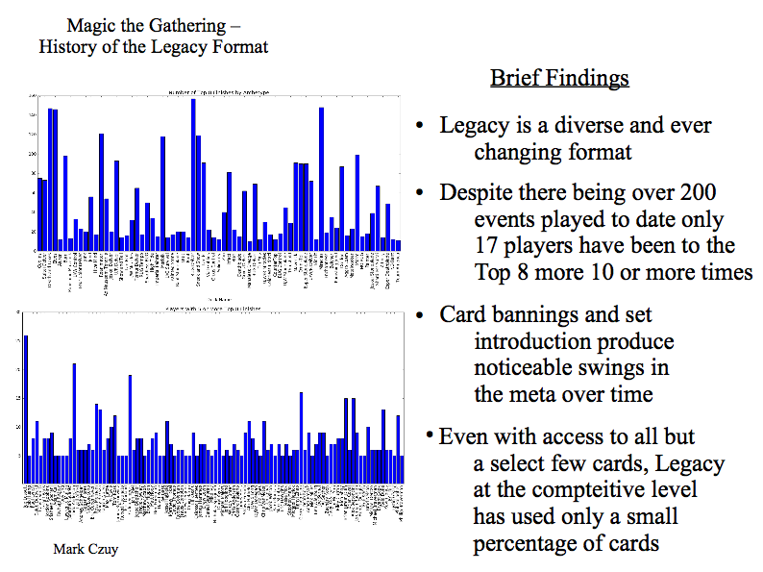

Slide 16
90 Second Previews
Roberto Martinez
Samantha Cardi
Steven Caraballo
Mark Czuy
Anthony Beltran
Tajh McDonald
Francisco Perez
Yusef Abdulla
Osnaldy Vasquez
Edgar Lucero
Elaine Burchman
Antonio Peralta
Rosanna De Leon Rodriguez & Yelso Yanez
Josue Rojas
Rodny Perez
Aurora Koch-Pongsema
Marlon Figuero Lopez
Nicholas Wilk

Slide 17


Slide 18
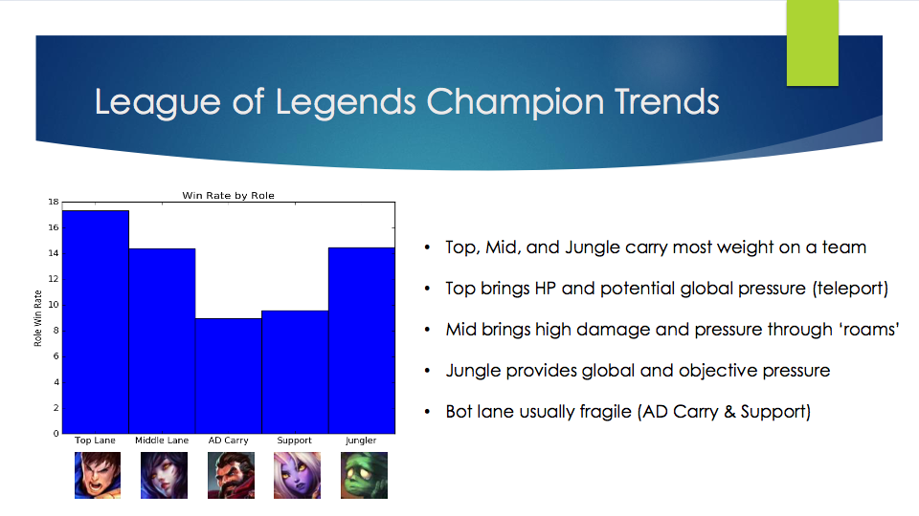

Slide 19
90 Second Previews
Roberto Martinez
Samantha Cardi
Steven Caraballo
Mark Czuy
Anthony Beltran
Tajh McDonald
Francisco Perez
Yusef Abdulla
Osnaldy Vasquez
Edgar Lucero
Elaine Burchman
Antonio Peralta
Rosanna De Leon Rodriguez & Yelso Yanez
Josue Rojas
Rodny Perez
Aurora Koch-Pongsema
Marlon Figuero Lopez
Nicholas Wilk

Slide 20


Slide 21
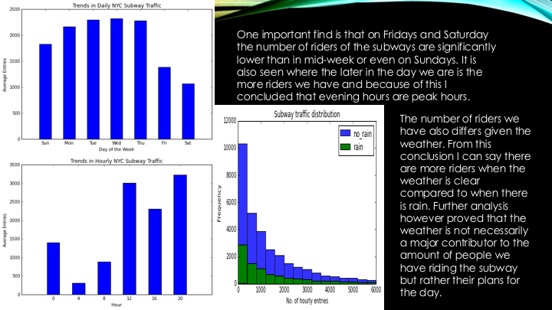

Slide 22
90 Second Previews
Roberto Martinez
Samantha Cardi
Steven Caraballo
Mark Czuy
Anthony Beltran
Tajh McDonald
Francisco Perez
Yusef Abdulla
Osnaldy Vasquez
Edgar Lucero
Elaine Burchman
Antonio Peralta
Rosanna De Leon Rodriguez & Yelso Yanez
Josue Rojas
Rodny Perez
Aurora Koch-Pongsema
Marlon Figuero Lopez
Nicholas Wilk

Slide 23


Slide 24
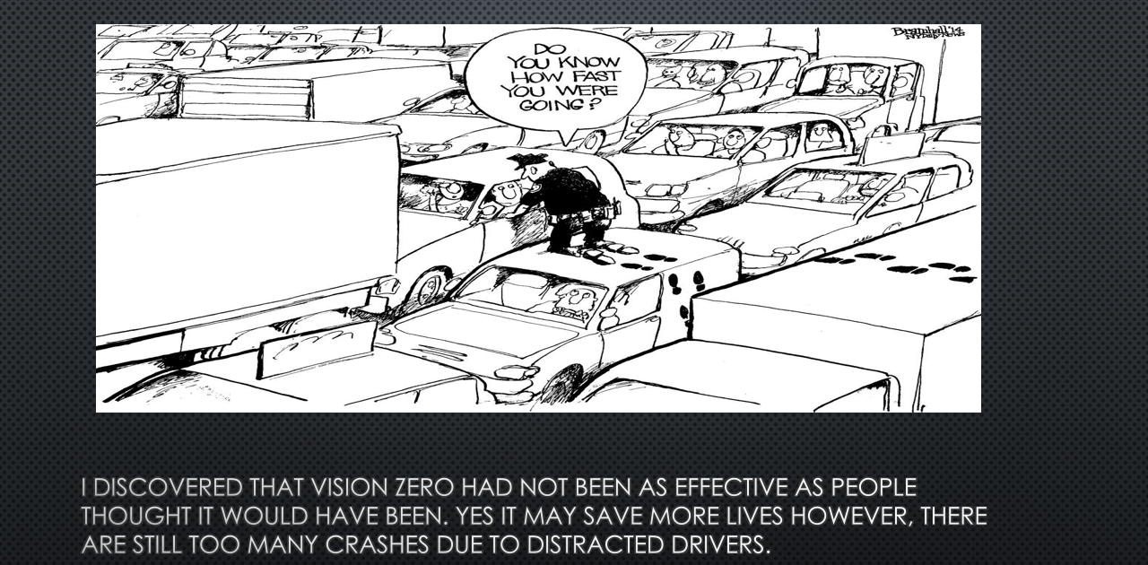

Slide 25
90 Second Previews
Roberto Martinez
Samantha Cardi
Steven Caraballo
Mark Czuy
Anthony Beltran
Tajh McDonald
Francisco Perez
Yusef Abdulla
Osnaldy Vasquez
Edgar Lucero
Elaine Burchman
Antonio Peralta
Rosanna De Leon Rodriguez & Yelso Yanez
Josue Rojas
Rodny Perez
Aurora Koch-Pongsema
Marlon Figuero Lopez
Nicholas Wilk

Slide 26


Slide 27
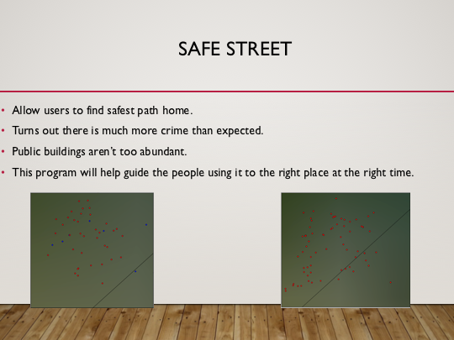

Slide 28
90 Second Previews
Roberto Martinez
Samantha Cardi
Steven Caraballo
Mark Czuy
Anthony Beltran
Tajh McDonald
Francisco Perez
Yusef Abdulla
Osnaldy Vasquez
Edgar Lucero
Elaine Burchman
Antonio Peralta
Rosanna De Leon Rodriguez & Yelso Yanez
Josue Rojas
Rodny Perez
Aurora Koch-Pongsema
Marlon Figuero Lopez
Nicholas Wilk

Slide 29
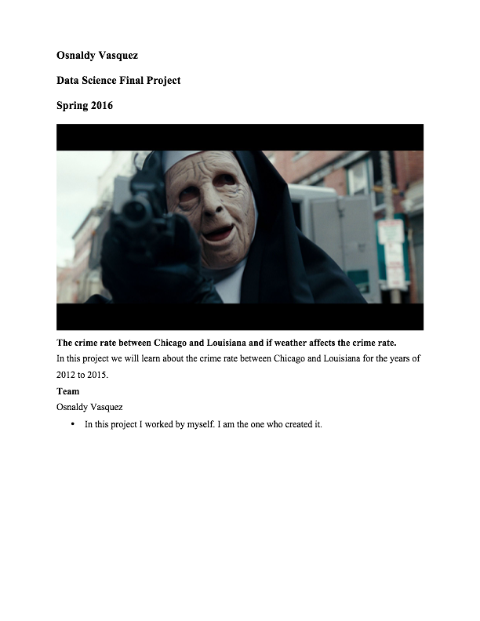

Slide 30
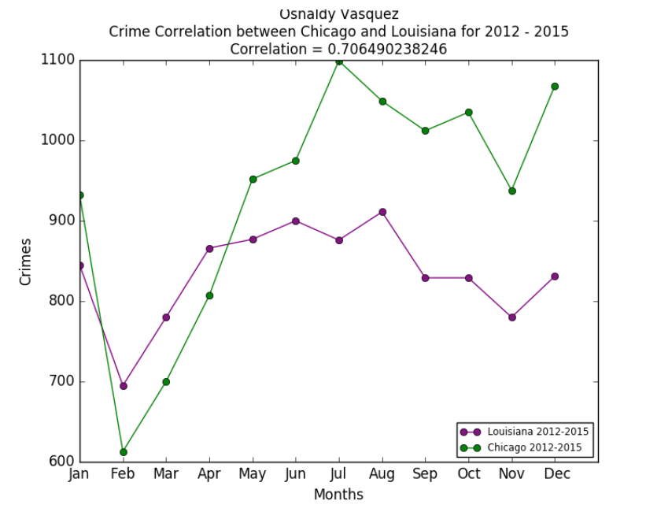

Slide 31
90 Second Previews
Roberto Martinez
Samantha Cardi
Steven Caraballo
Mark Czuy
Anthony Beltran
Tajh McDonald
Francisco Perez
Yusef Abdulla
Osnaldy Vasquez
Edgar Lucero
Elaine Burchman
Antonio Peralta
Rosanna De Leon Rodriguez & Yelso Yanez
Josue Rojas
Rodny Perez
Aurora Koch-Pongsema
Marlon Figuero Lopez
Nicholas Wilk

Slide 32


Slide 33
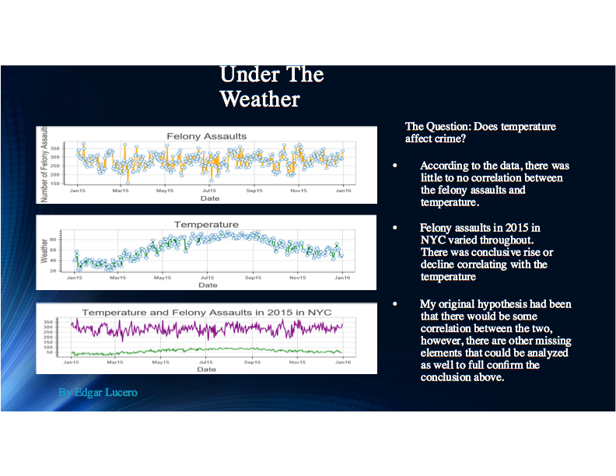

Slide 34
90 Second Previews
Roberto Martinez
Samantha Cardi
Steven Caraballo
Mark Czuy
Anthony Beltran
Tajh McDonald
Francisco Perez
Yusef Abdulla
Osnaldy Vasquez
Edgar Lucero
Elaine Burchman
Antonio Peralta
Rosanna De Leon Rodriguez & Yelso Yanez
Josue Rojas
Rodny Perez
Aurora Koch-Pongsema
Marlon Figuero Lopez
Nicholas Wilk

Slide 35
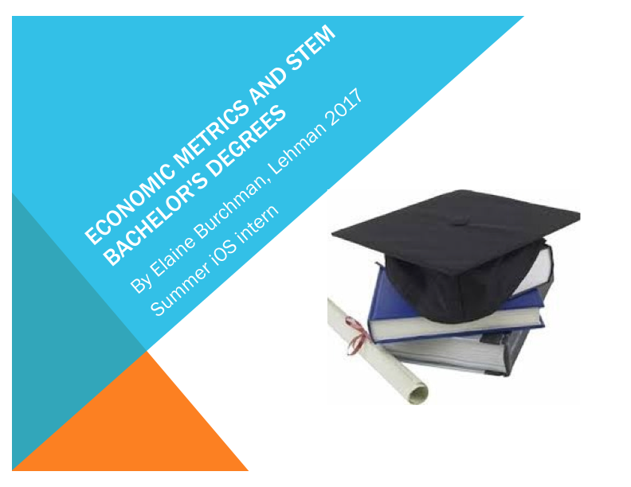

Slide 36
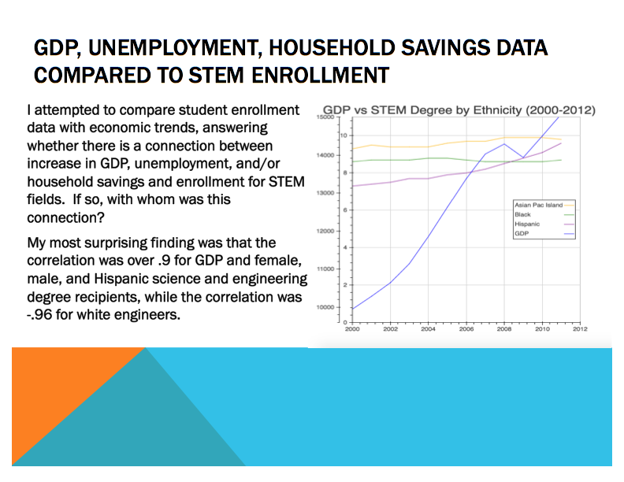

Slide 37
90 Second Previews
Roberto Martinez
Samantha Cardi
Steven Caraballo
Mark Czuy
Anthony Beltran
Tajh McDonald
Francisco Perez
Yusef Abdulla
Osnaldy Vasquez
Edgar Lucero
Elaine Burchman
Antonio Peralta
Rosanna De Leon Rodriguez & Yelso Yanez
Josue Rojas
Rodny Perez
Aurora Koch-Pongsema
Marlon Figuero Lopez
Nicholas Wilk

Slide 38
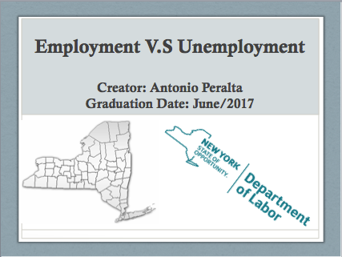

Slide 39


Slide 40
90 Second Previews
Roberto Martinez
Samantha Cardi
Steven Caraballo
Mark Czuy
Anthony Beltran
Tajh McDonald
Francisco Perez
Yusef Abdulla
Osnaldy Vasquez
Edgar Lucero
Elaine Burchman
Antonio Peralta
Rosanna De Leon Rodriguez & Yelso Yanez
Josue Rojas
Rodny Perez
Aurora Koch-Pongsema
Marlon Figuero Lopez
Nicholas Wilk

Slide 41
90 Second Previews
Roberto Martinez
Samantha Cardi
Steven Caraballo
Mark Czuy
Anthony Beltran
Tajh McDonald
Francisco Perez
Yusef Abdulla
Osnaldy Vasquez
Edgar Lucero
Elaine Burchman
Antonio Peralta
Rosanna De Leon Rodriguez & Yelso Yanez
Josue Rojas
Rodny Perez
Aurora Koch-Pongsema
Marlon Figuero Lopez
Nicholas Wilk

Slide 42
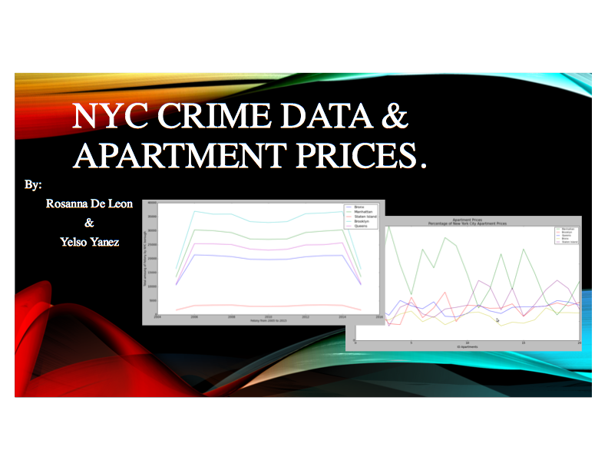

Slide 43
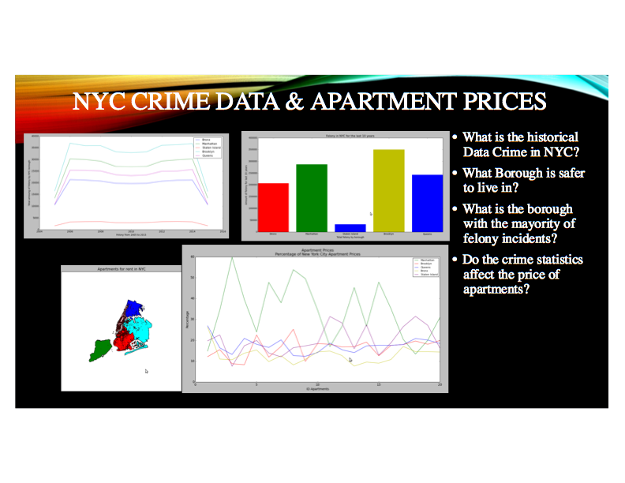

Slide 44
90 Second Previews
Roberto Martinez
Samantha Cardi
Steven Caraballo
Mark Czuy
Anthony Beltran
Tajh McDonald
Francisco Perez
Yusef Abdulla
Osnaldy Vasquez
Edgar Lucero
Elaine Burchman
Antonio Peralta
Rosanna De Leon Rodriguez & Yelso Yanez
Josue Rojas
Rodny Perez
Aurora Koch-Pongsema
Marlon Figuero Lopez
Nicholas Wilk

Slide 45


Slide 46
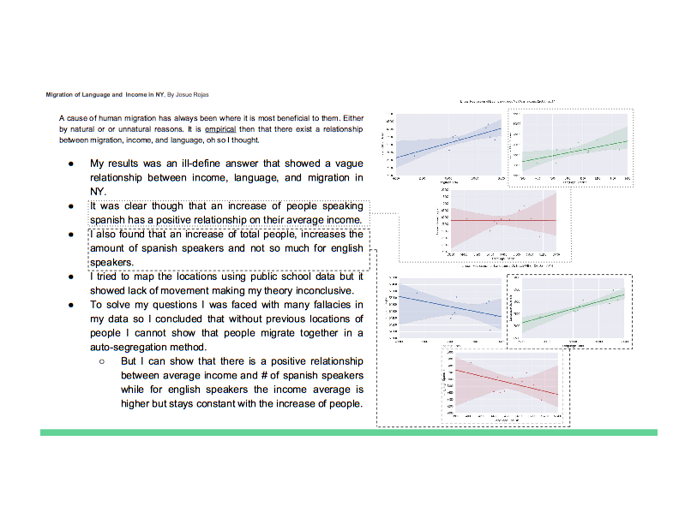

Slide 47
90 Second Previews
Roberto Martinez
Samantha Cardi
Steven Caraballo
Mark Czuy
Anthony Beltran
Tajh McDonald
Francisco Perez
Yusef Abdulla
Osnaldy Vasquez
Edgar Lucero
Elaine Burchman
Antonio Peralta
Rosanna De Leon Rodriguez & Yelso Yanez
Josue Rojas
Rodny Perez
Aurora Koch-Pongsema
Marlon Figuero Lopez
Nicholas Wilk

Slide 48


Slide 49
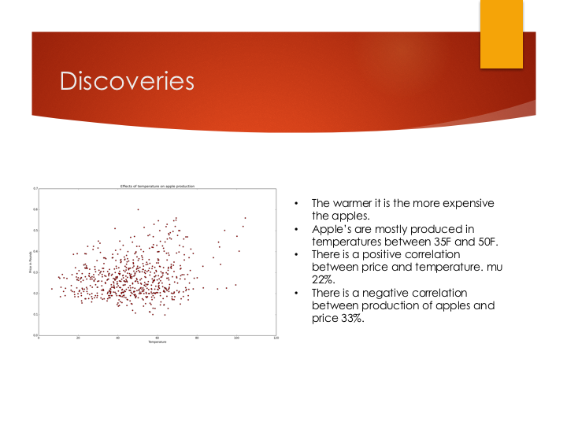

Slide 50
90 Second Previews
Roberto Martinez
Samantha Cardi
Steven Caraballo
Mark Czuy
Anthony Beltran
Tajh McDonald
Francisco Perez
Yusef Abdulla
Osnaldy Vasquez
Edgar Lucero
Elaine Burchman
Antonio Peralta
Rosanna De Leon Rodriguez & Yelso Yanez
Josue Rojas
Rodny Perez
Aurora Koch-Pongsema
Marlon Figuero Lopez
Nicholas Wilk

Slide 51


Slide 52
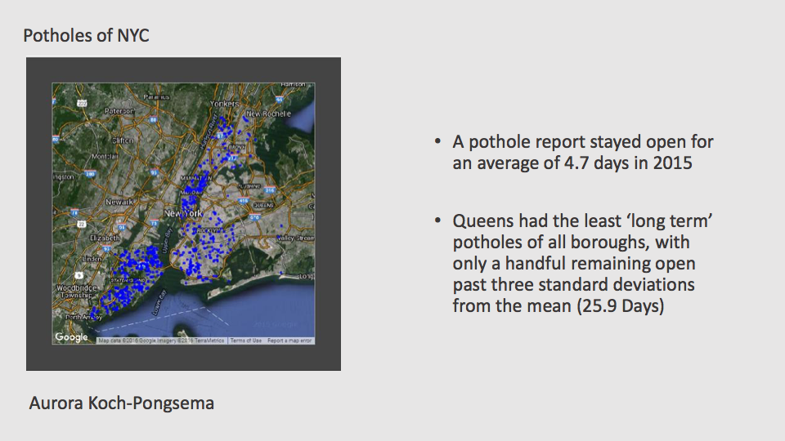

Slide 53
90 Second Previews
Roberto Martinez
Samantha Cardi
Steven Caraballo
Mark Czuy
Anthony Beltran
Tajh McDonald
Francisco Perez
Yusef Abdulla
Osnaldy Vasquez
Edgar Lucero
Elaine Burchman
Antonio Peralta
Rosanna De Leon Rodriguez & Yelso Yanez
Josue Rojas
Rodny Perez
Aurora Koch-Pongsema
Marlon Figuero Lopez
Nicholas Wilk

Slide 54
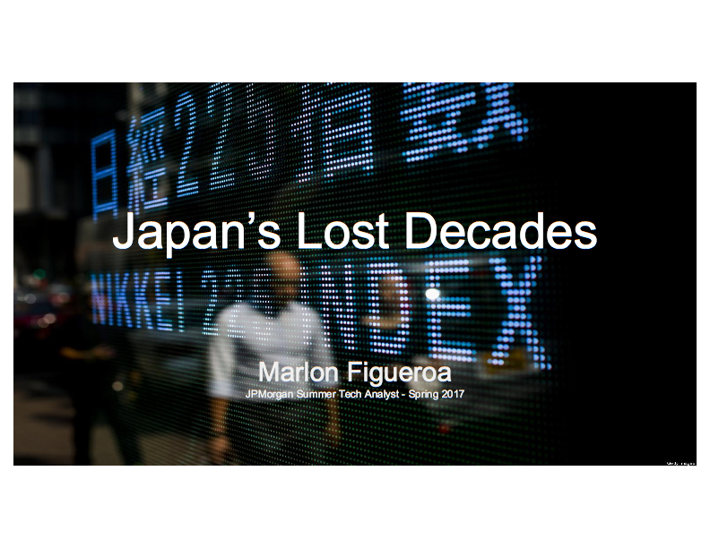

Slide 55
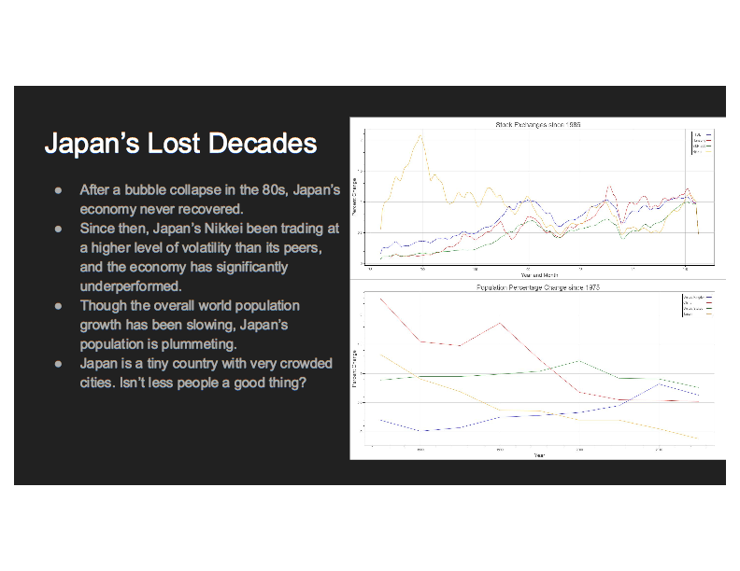

Slide 56
90 Second Previews
Roberto Martinez
Samantha Cardi
Steven Caraballo
Mark Czuy
Anthony Beltran
Tajh McDonald
Francisco Perez
Yusef Abdulla
Osnaldy Vasquez
Edgar Lucero
Elaine Burchman
Antonio Peralta
Rosanna De Leon Rodriguez & Yelso Yanez
Josue Rojas
Rodny Perez
Aurora Koch-Pongsema
Marlon Figuero Lopez
Nicholas Wilk

Slide 57


Slide 58
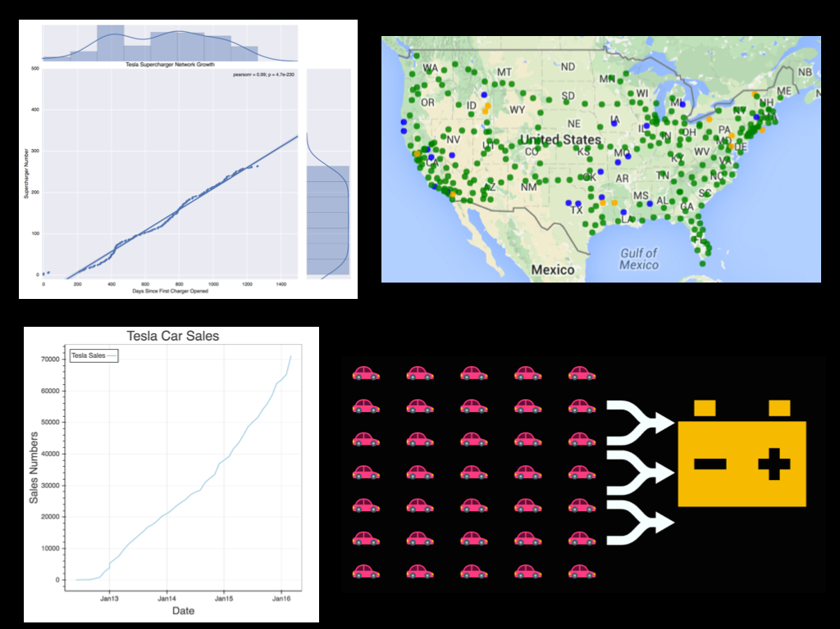

Slide 59
Poster Session

